Slide 1



Project Title: Heart Disease
Name of Student:
Satish M (AF0378136)
GUIDE:
Mr. Shivakumar Selvam

Slide 2
Contents
Review
Introduction
Existing Problem Statement
Motivation
Aim and Objective
Hardware and Software requriments
Results
Conclusion
References

Slide 3
Introduction
The heart disease dataset comprises related to patient information, including demographic details, medical history, diagnostic tests, and outcomes.
It offers a valuable resource for analyzing factors associated with heart disease incidence, progression, and treatment response.
Researchers and healthcare professionals can utilize this dataset to identify patterns, risk factors, and potential interventions to improve patient outcomes and public health strategies.

Slide 4
Problem Statement
Heart disease continues to be a prominent cause of illness and death worldwide.
Despite efforts to raise awareness and improve medical treatments, the prevalence of heart disease remains high.
Addressing the multifaceted challenges posed by heart disease requires comprehensive strategies that encompass prevention, early detection, and effective management.

Slide 5
Motivation
With this dataset, we can learn important things about heart disease that can help save lives.
By studying the data, we can find better ways to prevent and treat heart problems.
Let's use this information to make a real difference in improving heart health for everyone.

Slide 6

Aims:
To provide a comprehensive understanding of heart disease, its risk factors, prevention strategies, and treatment options.
Objectives:
Explain what things increase the chances of getting heart disease and how lifestyle changes can help prevent it.
Talk about the different types of heart problems and how doctors diagnose and treat them.
Encourage people to join the conversation about how they can take care of their hearts and when to see a doctor if they have concerns.

Slide 7
Hardware and Software Requirements
Processor: Intel Core i5 or equivalent (minimum), Intel Core i7 or higher (recommended)
RAM: 8 GB (minimum), 16 GB or more (recommended)
Storage: 256 GB SSD (minimum), 512 GB SSD or more (recommended)
Graphics: Integrated graphics for basic visualization, dedicated GPU for more intensive visualizations
Display: Full HD monitor (1920x1080 resolution) or higher
Internet Connection: Stable internet connection for downloading datasets and libraries

Slide 8
SOFTWARE REQUIREMENTS:
Operating System:
Windows 10 or higher
macOS 10.14 (Mojave) or higher
Linux (any modern distribution)
Programming Languages:
Python 3.6 or higher
Python Libraries:
pandas: For data manipulation and analysis.

Slide 9
IDE/Text Editor:
Jupyter Notebook/JupyterLab (recommended for EDA)
Visual Studio Code
PyCharm

Slide 10
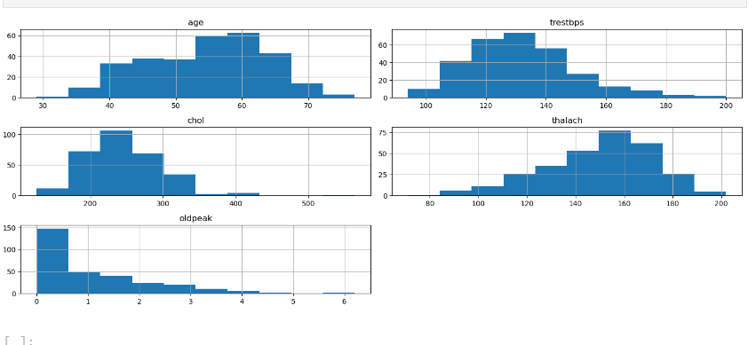
Results

Slide 11
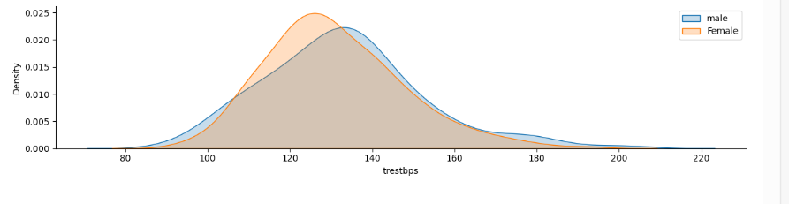
Results

Slide 12
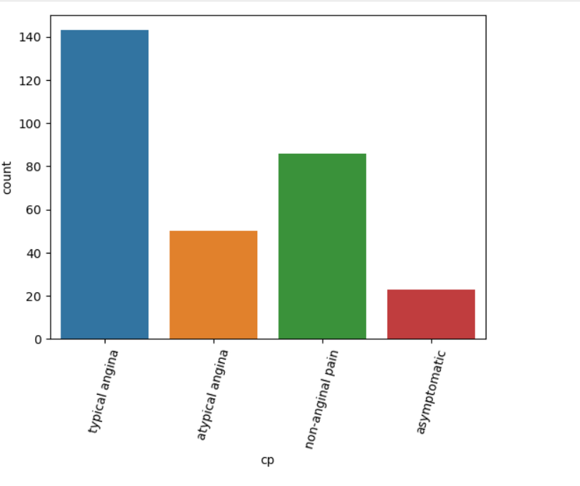

Slide 13
Heart disease is a major global health concern.
Prevention through lifestyle changes like healthy eating and exercise is key.
Early detection and prompt medical attention are crucial for better heart health outcomes.

Slide 14
References
1. S. S. Virani et al., “Heart disease and stroke statistics”—2020 update.
2. J. Bostrom, G. Sweeney, J. Whiteson, and J. A. Dodson, “Mobile health and cardiac rehabilitation in older adults”. 3. G. A. Roth et al., “Global burden of cardiovascular diseases and risk factors, 1990–2019”.
4. S. B. Shuvo, S. N. Ali, S. I. Swapnil, T. Hasan, and M. I. H. Bhuiyan, “A lightweight CNN model for detecting respiratory diseases from lung auscultation sounds using EMD-CWT-based hybrid scalogram”.
5. B. Keerthi Samhitha, M. Sarika Priya., C. Sanjana., S. C. Mana, and J. Jose, “Improving the accuracy in prediction of heart disease using machine learning algorithms”.
6. R. Spencer, F. Thabtah, N. Abdelhamid, and M. Thompson, “Exploring feature selection and classification methods for predicting heart disease”.

Slide 15


